Slide 1
The Python Data Visualization Landscape

Slide 2

Bence Arató
Director, BI Consulting
Data architect and analyst with 15+ years of experience
Visiting professor at CEU, teaching data visualization and visual analytics
PyData Budapest meetup organizer

Slide 3
Data visualization with Python

Slide 4
Why use Python?

Slide 5

Using Python code for dataviz
What are the benefits?
Notes:
How many charts do we know?
And how many types are we actively using?

Slide 6
What are the benefits?
Why code?
Code can be easily duplicated/modified/iterated
Code-based visualizations are reproducible
Code-based visualizations can be automated
Code-based visualizations can be easily documented
Why Python?
You might be already working in Python
Python has good support for charting
Also support all kind of interoperability
Complex data processing pipelines
Integrate charts into Powerpoint or Word
Machine learning applications
Notes:
Ref: https://slideplayer.com/slide/13891537/ Jeffrey Shaffer – nem lehet letölteni,csak nézegetni Dashboardról is szól.

Slide 7
Dataviz in Python

Slide 8
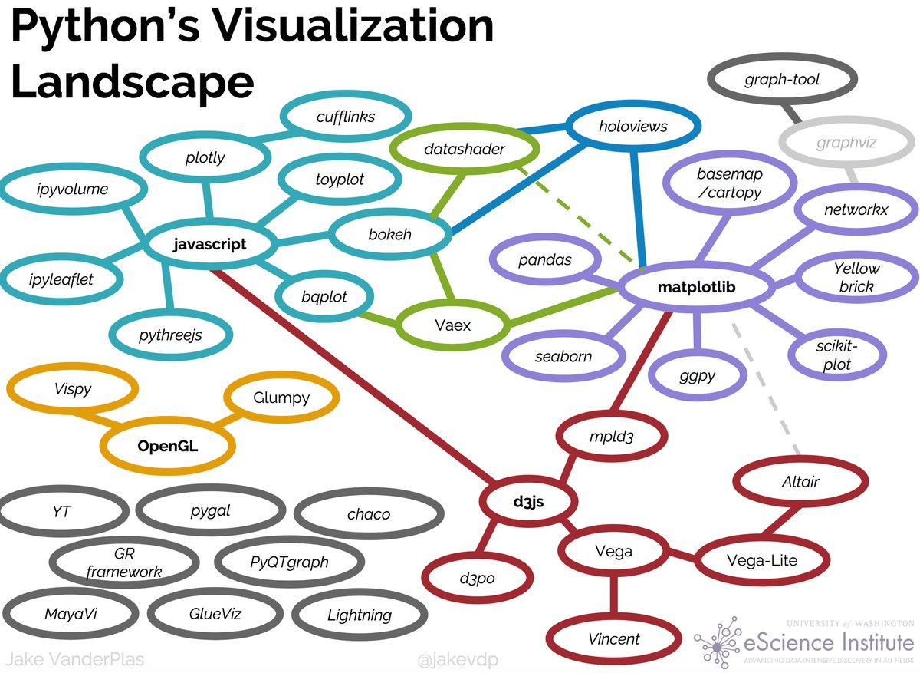
The reason behind this talk
Jake VanderPlas

Slide 9
Dataviz in Python
How you can create charts in Python?
Notes:
How many charts do we know?
And how many types are we actively using?

Slide 10
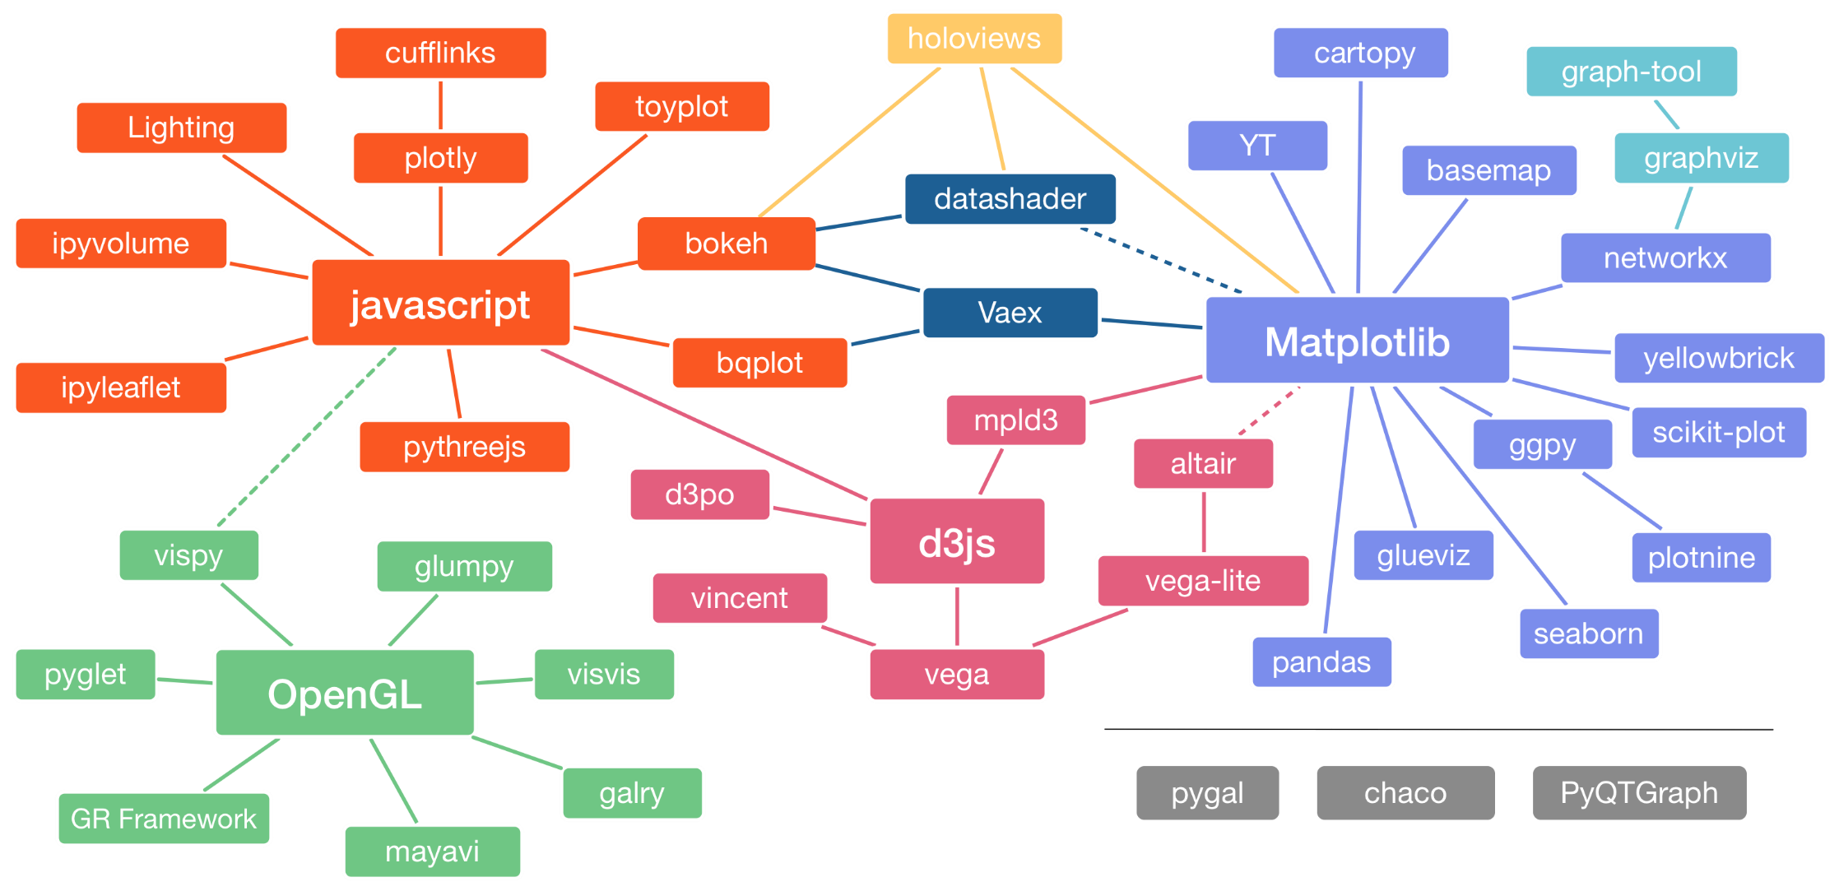
Dataviz in Python
https://pyviz.org/overviews/

Slide 11
Dataviz in Python
Python has many data visualization tools
Maybe too many ☺
You can think of the main categories as
Classic or „old school” dataviz tools (e.g matplotlib)
Modern dataviz libraries (plotly, altair, holoviz)
Special libraries for people already familiar with dataviz in other languages / frameworks (e.g plotnine for R/ggplot2 users)
There are 3 layers
Low-level charting libraries – main goal is functionality
High-level charting libraries – main goal is ease of use
Dashboarding libraries – for assembling charts into interactive data apps

Slide 12
Two styles of data visualization
Imperative
Specify How something should be done
Must manually specify all plotting steps
Specification & execution intertwined
Typically used by lower-level libraries
Code often longer, more detailed
Declarative
Specify What should be done
Details determined automatically
Specification and execution separated
Typically used by higher level libraries
Code usually shorter, more expressive
Adapted from Jake VanderPlas’s „Bespoke-Visualizations-Python” talk

Slide 13
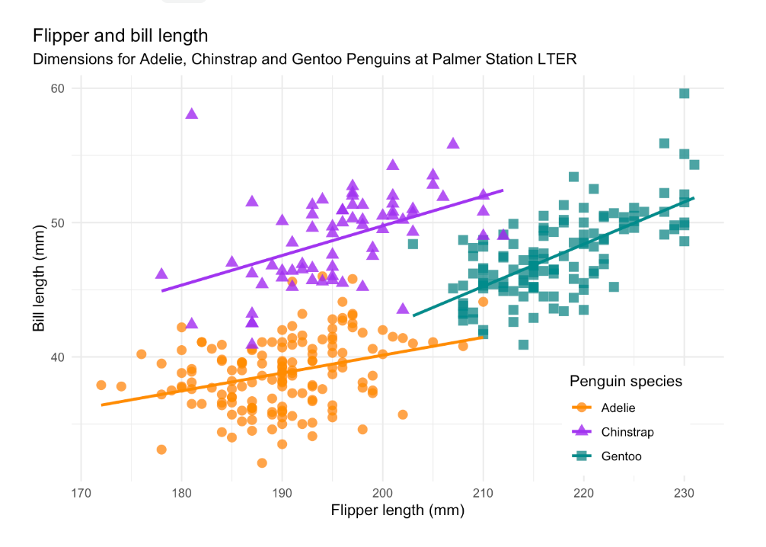
The penguin dataset used in the examples
github.com/allisonhorst/palmerpenguins

Slide 14
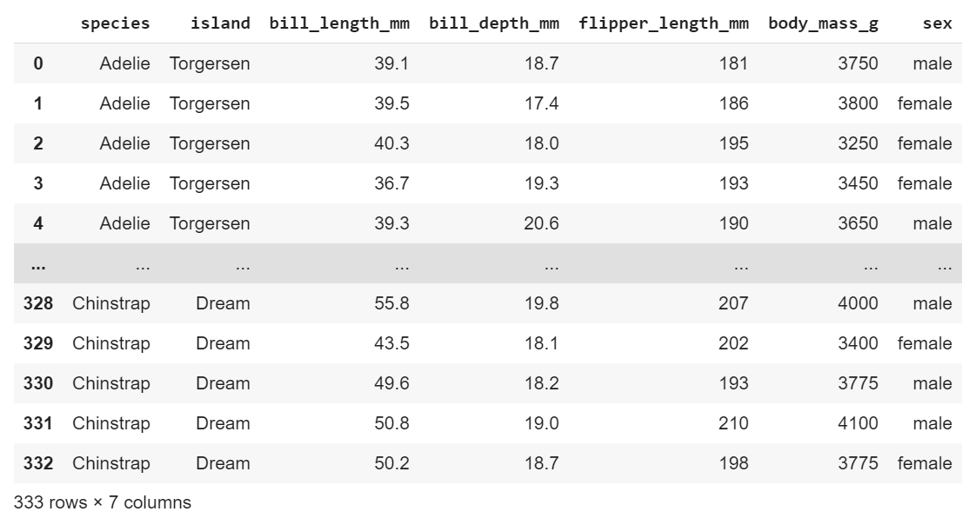
The penguin dataframe in pandas
Cleaned version from https://raw.githubusercontent.com/dataprofessor/data/master/penguins_cleaned.csv

Slide 15
Acknowledgements
This talk would not exits without the help and materials of:
Philipp Rudiger, Anaconda
Jim Bednar, Anaconda
Nicholas Kruchten, Plotly
Jake VanderPlas, Altair
Maarten Breddels, Voila
Randy Zwitch, Streamlit
Special thanks to
Jim Bednar and Nicholas Kruchten for providing feedback
Anett Labancz for the help with the code examples

Slide 16
A word of caution
The Python dataviz landscape is large and this talk only covers a subset of the libraries (see the end of the talk for more!)
All libraries have pros and cons, and there is always some subjectivity in evaluating them. Your mileage may vary.
The code samples were ran on Google Colab, other environments might require some changes (e.g. installing non-default libraries)

Slide 17
Charting libraries

Slide 18
Group #1

Slide 19
Matplotlib

Slide 20
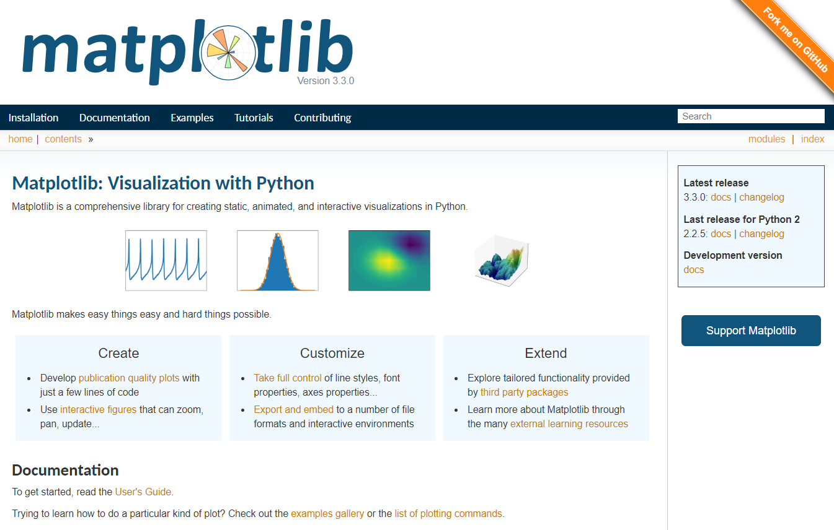
Matplotlib
matplotlib.org

Slide 21
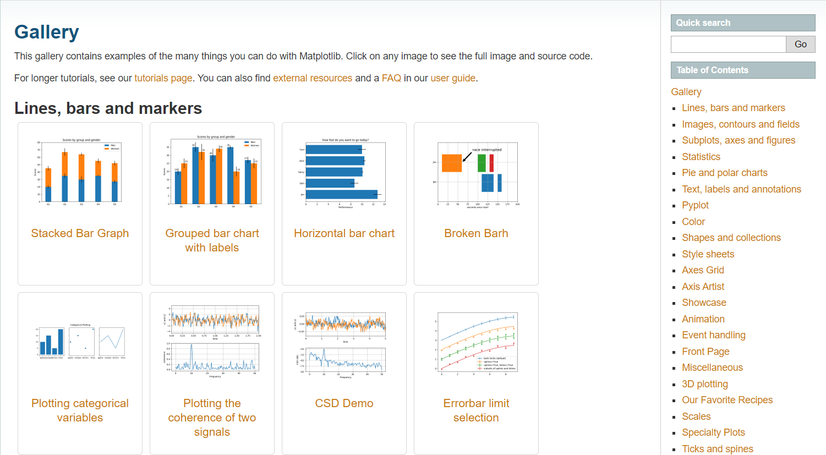
Matplotlib
matplotlib.org/3.1.0/gallery

Slide 22
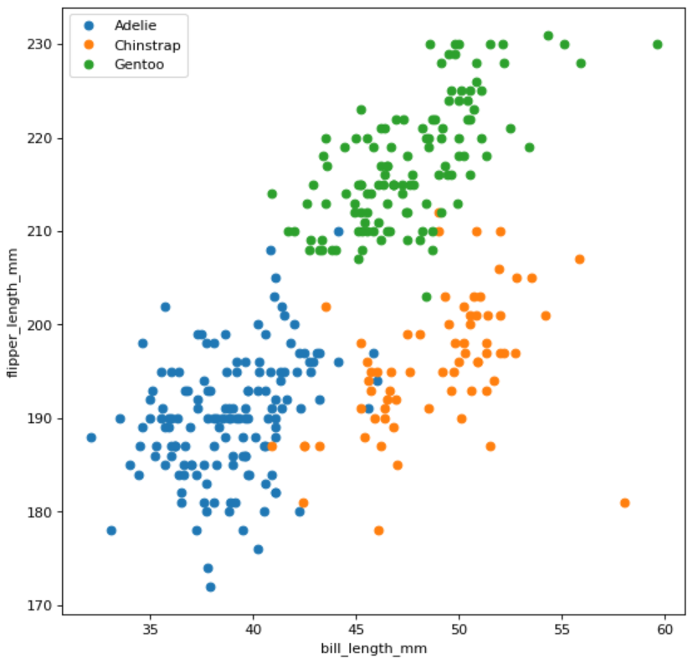
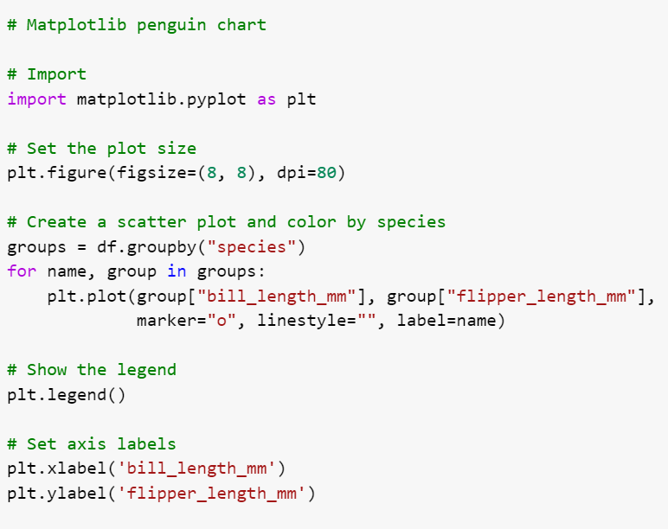
Matplotlib

Slide 23
Background
Charting libraries
MATLAB
Matplotlib
@bencearato

Slide 24
Seaborn

Slide 25
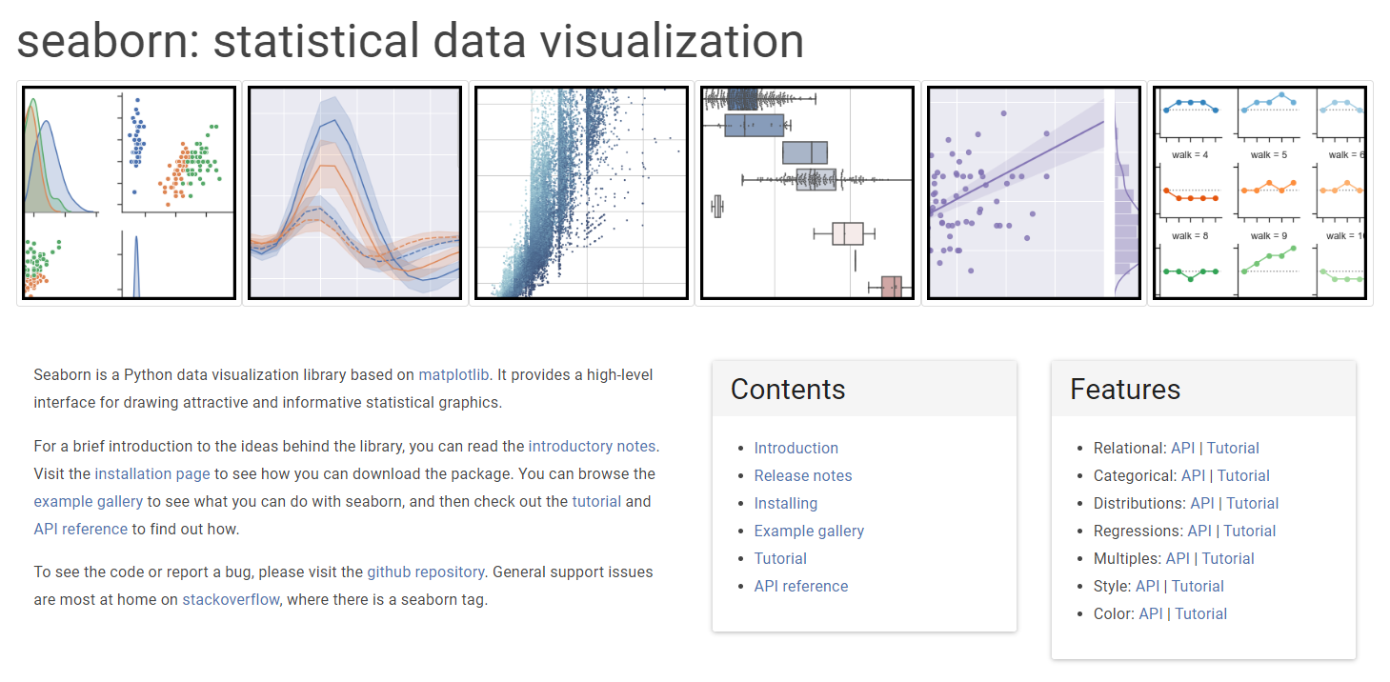
Seaborn
seaborn.pydata.org

Slide 26
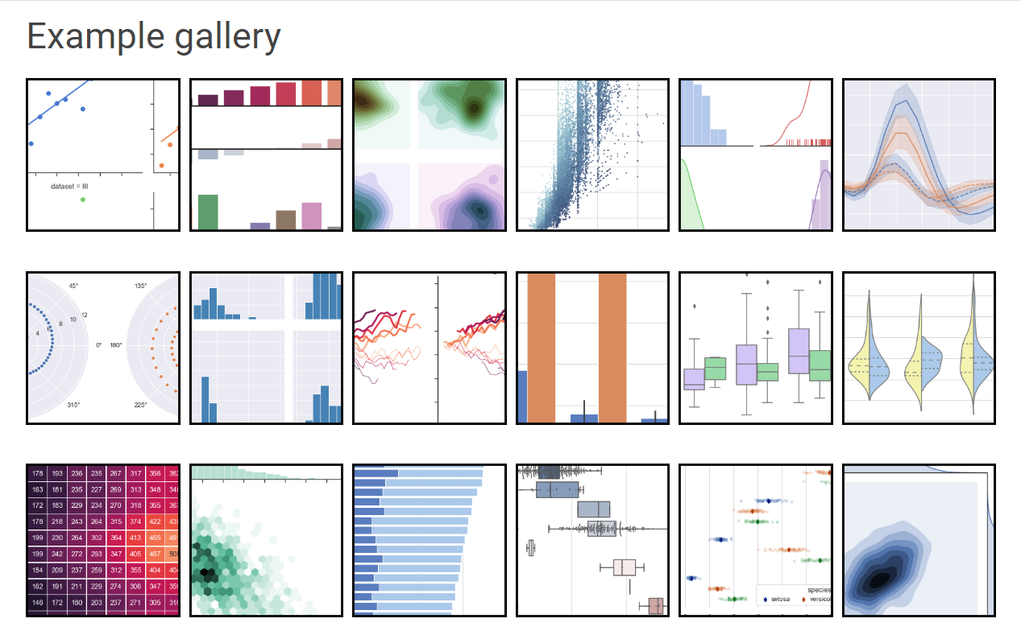
Seaborn
seaborn.pydata.org/examples

Slide 27
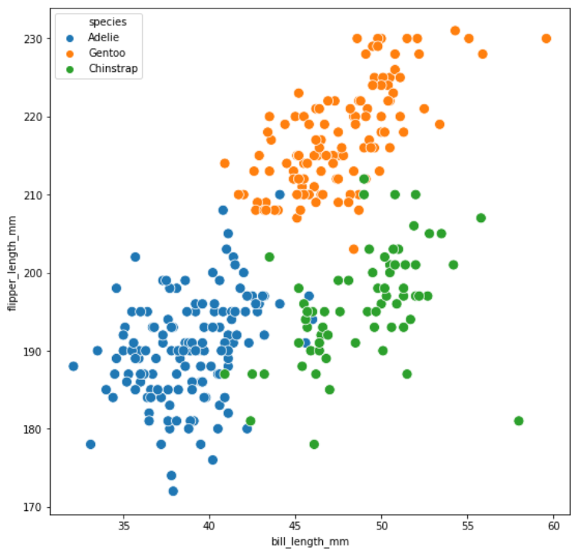
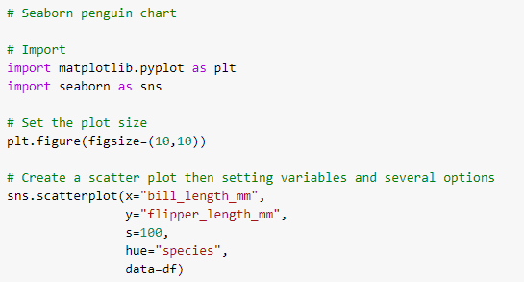
Seaborn

Slide 28
plotnine

Slide 29
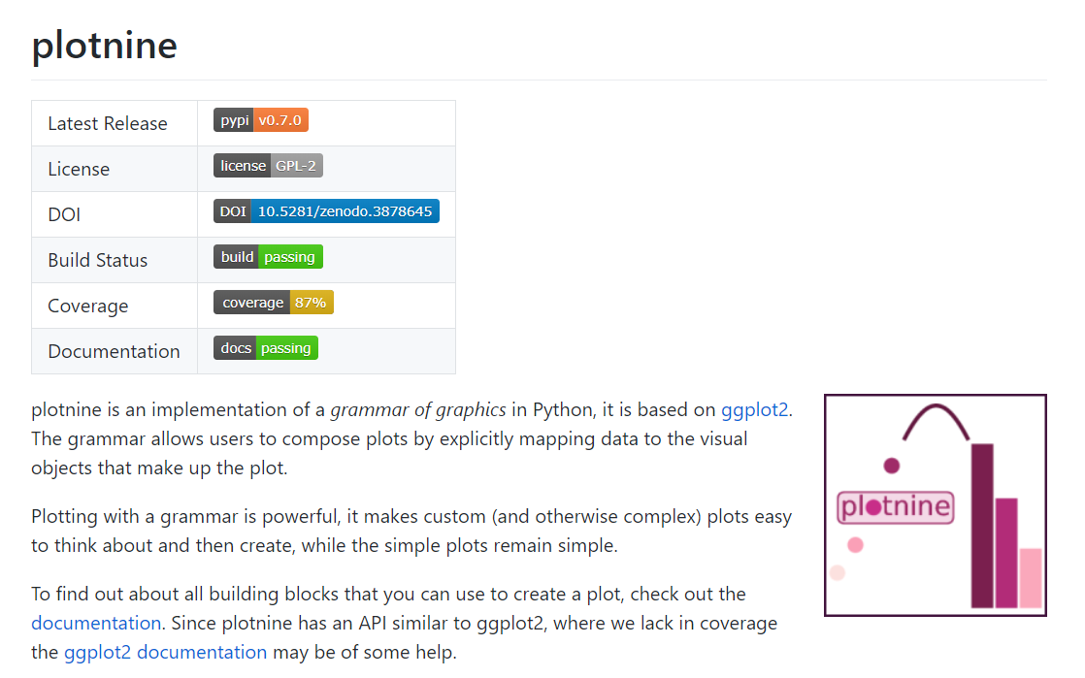
plotnine
github.com/has2k1/plotnine
Notes:
Nem D3.JS, nem ggplot2 kompatibilis: https://bokeh.pydata.org/en/0.10.0/docs/faq.html

Slide 30
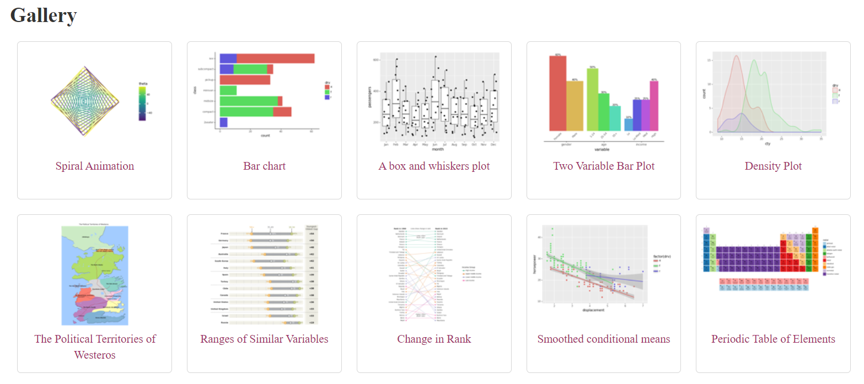
plotnine
plotnine.readthedocs.io/en/stable/gallery

Slide 31
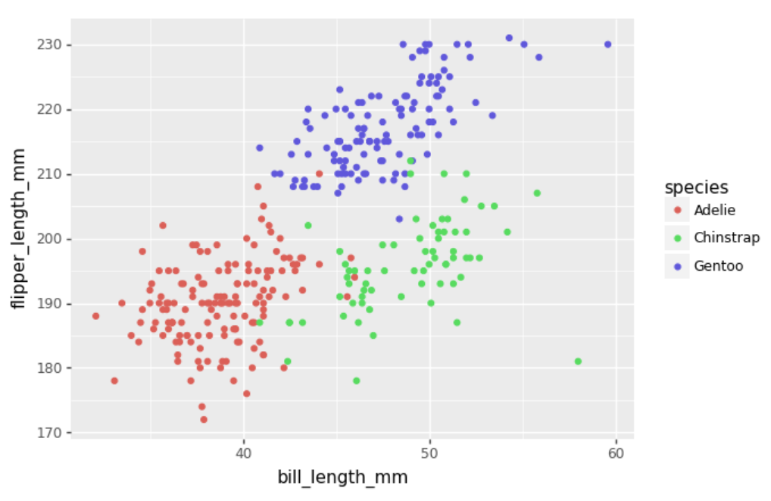
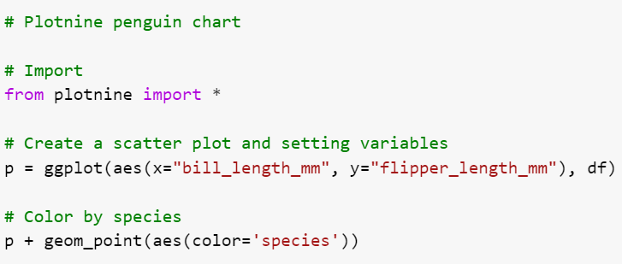
plotnine

Slide 32
Matplotlib, Seaborn, plotnine
Matplotlib background
Originally based on MATLAB
The doyen of the Python dataviz world, the most widely used library
Works for many-many use cases and has some unique features
Supports several backends and platforms
Some Matplotlib challenges
Low-level imperative approach, syntax could be verbose and difficult to master
Web/interactivity was not supported
Seaborn
high-level library built on Matplotlib
Focus on statistical visualizations
Nice visual defaults
plotnine
High-level library built on Matplotlib
Implements the Grammar of Graphic, based on R’s ggplot2

Slide 33
Background
Charting libraries
Ggplot2 (R)
plotnine
MATLAB
Matplotlib
Seaborn
@bencearato

Slide 34
Group #2

Slide 35
Bokeh

Slide 36
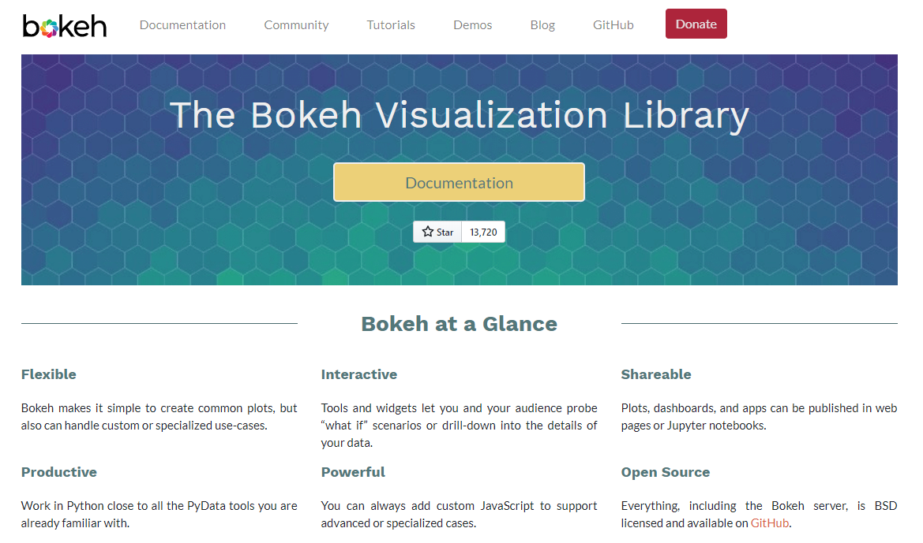
Bokeh
bokeh.org
Notes:
Nem D3.JS, nem ggplot2 kompatibilis: https://bokeh.pydata.org/en/0.10.0/docs/faq.html

Slide 37
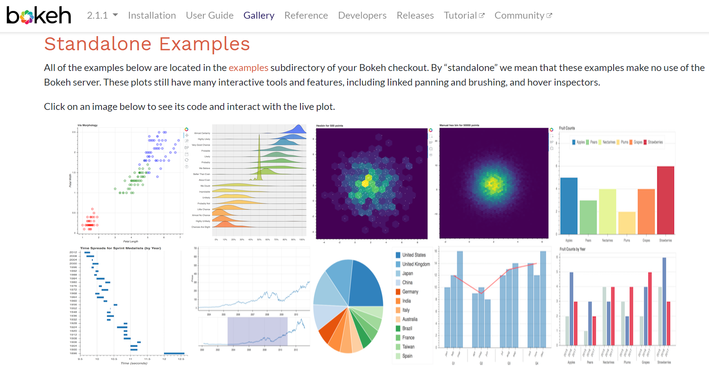
Bokeh
docs.bokeh.org/en/latest/docs/gallery.html

Slide 38
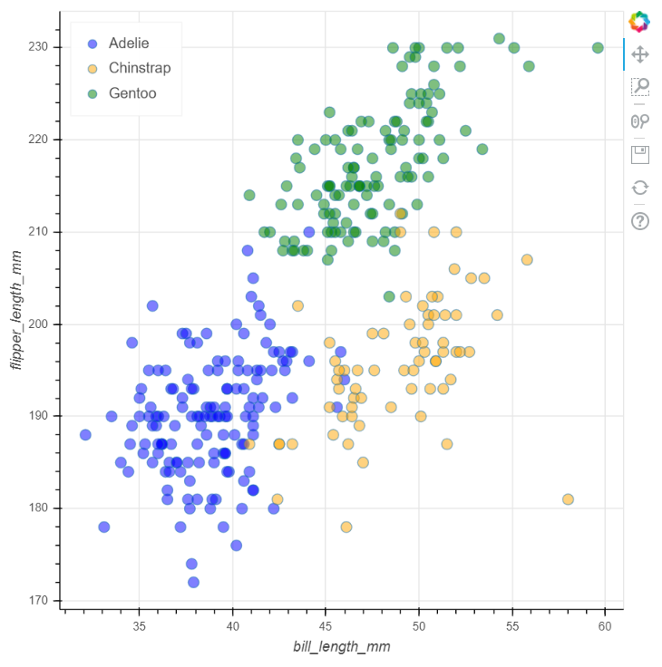
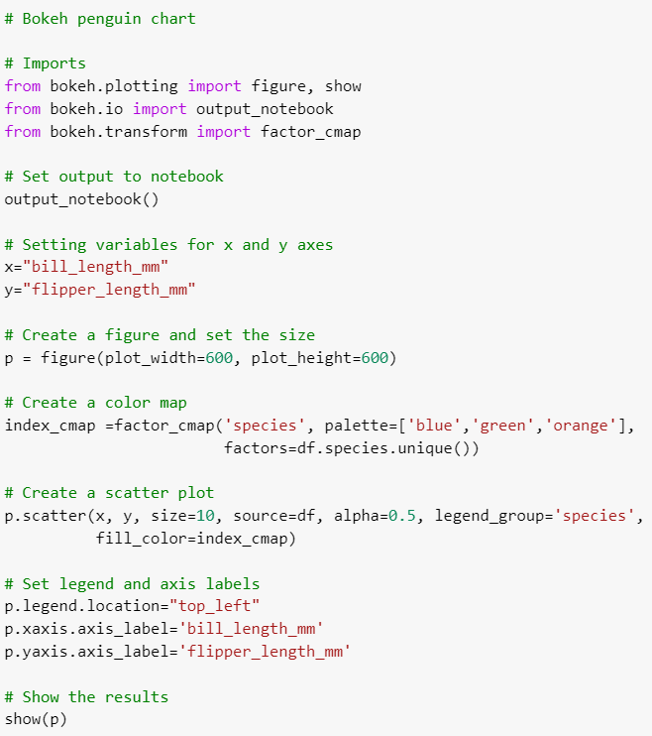
Bokeh

Slide 39
Background
Charting libraries
Ggplot2 (R)
plotnine
MATLAB
Matplotlib
Seaborn
Bokeh
Web / Javascript
@bencearato

Slide 40
Holoviews

Slide 41
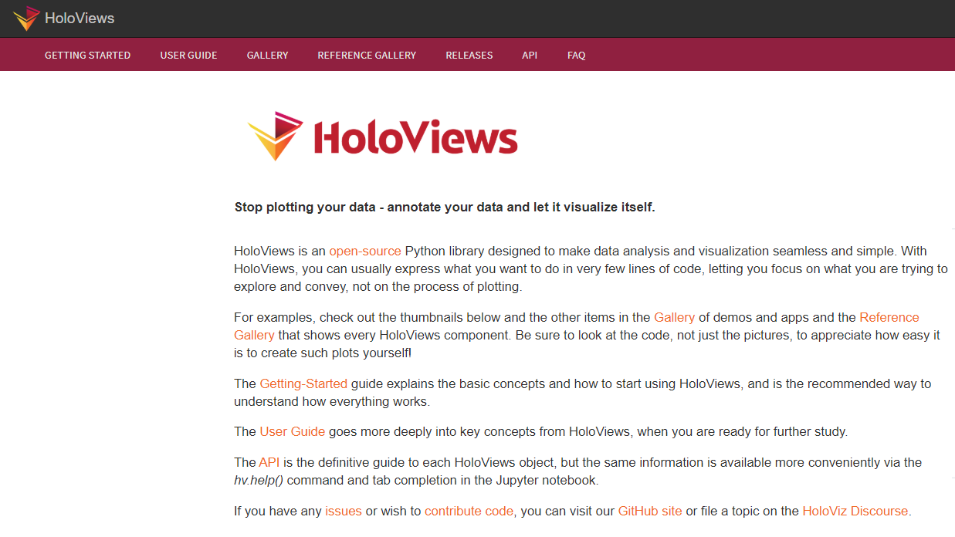
HoloViews
holoviews.org

Slide 42
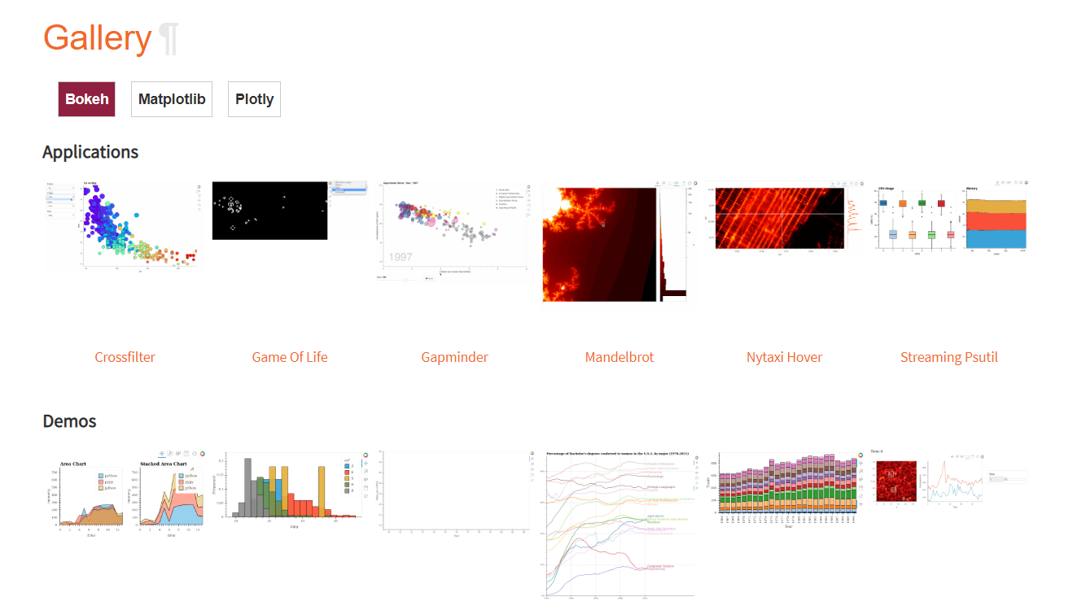
HoloViews
holoviews.org/gallery/index

Slide 43
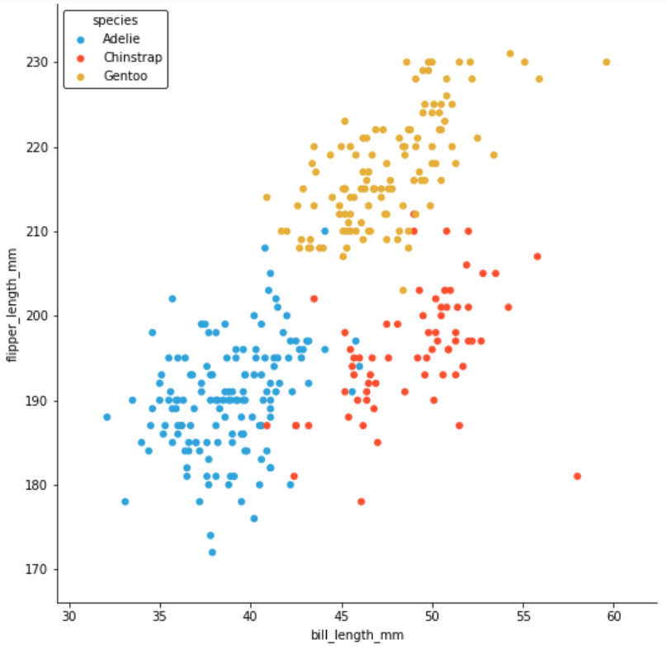
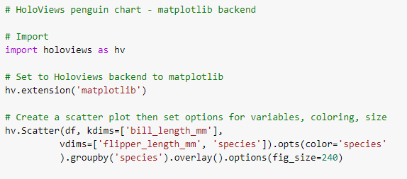
HoloViews

Slide 44
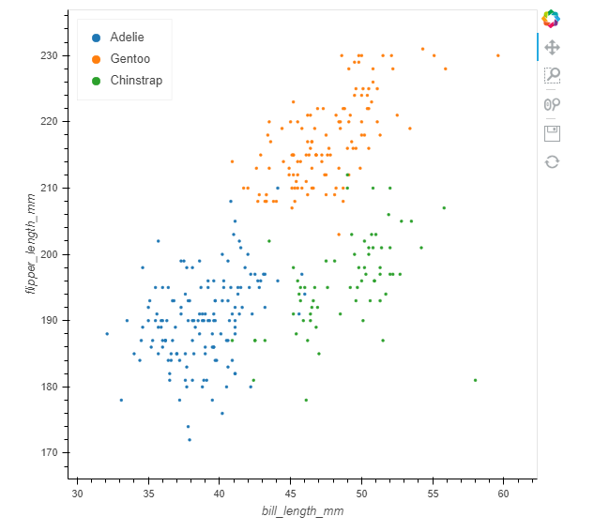
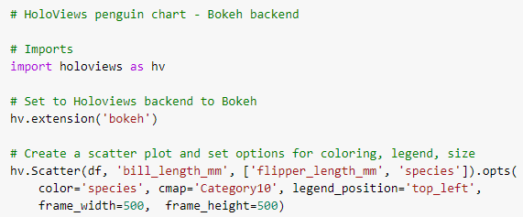
HoloViews

Slide 45
Background
Charting libraries
Ggplot2 (R)
plotnine
MATLAB
Matplotlib
Seaborn
Holoviews
Bokeh
Web / Javascript
@bencearato

Slide 46
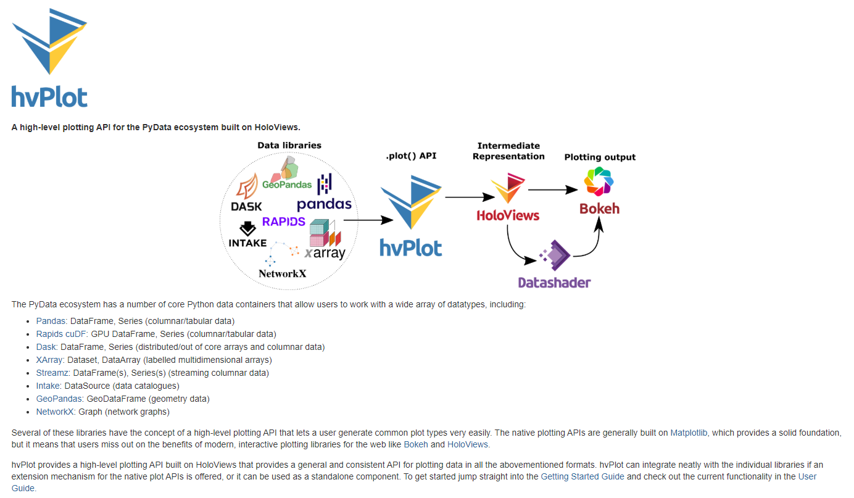
hvPlot
hvplot.holoviz.org

Slide 47
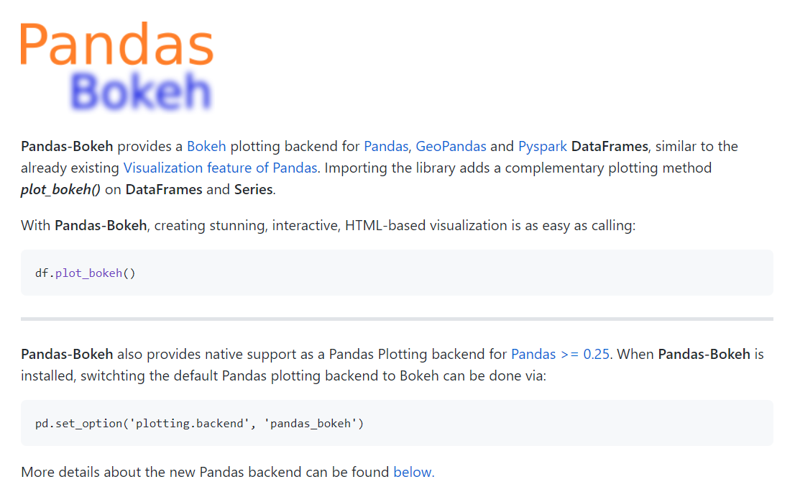
Bokeh
github.com/PatrikHlobil/Pandas-Bokeh

Slide 48
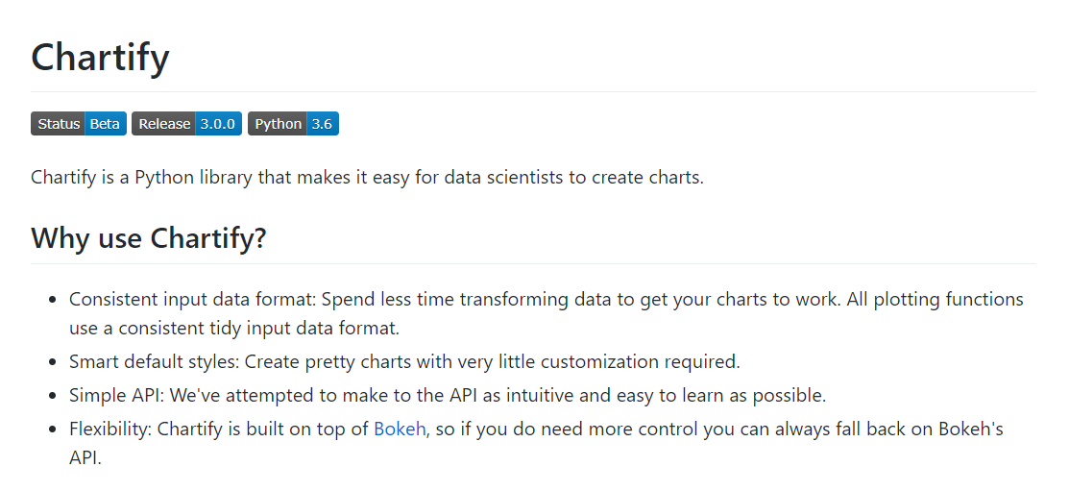
Chartify
github.com/spotify/chartify

Slide 49
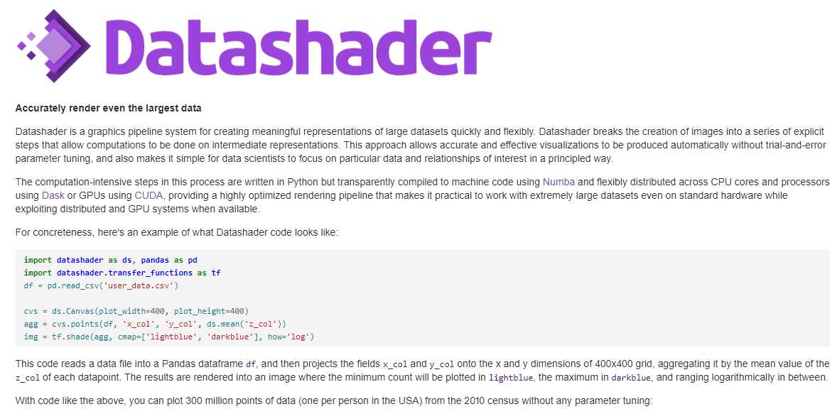
Datashader
datashader.org

Slide 50
Bokeh, HoloViews and related libraries
Bokeh
Created in 2013 to support web-based interactive charts in Python
Javascript-based rendering (bokeh.js)
Provides charts, widgets and server components/framework in one package
Dashboards and data applications also supported
Originally funded by the DARPA XDATA program, later by Anaconda/NUMFocus
Holoviews
Declarative objects that wrap your data and visualize themselves
Variety of data backends: Pandas, Dask, XArray, GeoPandas, etc.
Configurable plotting backends: Matplotlib (original), Bokeh (main), Plotly (in dev.)
Born out of PhD work in 2013
Other related libraries
hvPlot (based on Holoviews and Bokeh)
Pandas-Bokeh by Patrik Hlobil
Chartify from Spotify

Slide 51
Background
Charting libraries
Ggplot2 (R)
plotnine
MATLAB
Matplotlib
Seaborn
Holoviews
hvPlot
Bokeh
Chartify
Pandas-Bokeh
Web / Javascript
@bencearato

Slide 52
Group #3

Slide 53
Plotly

Slide 54
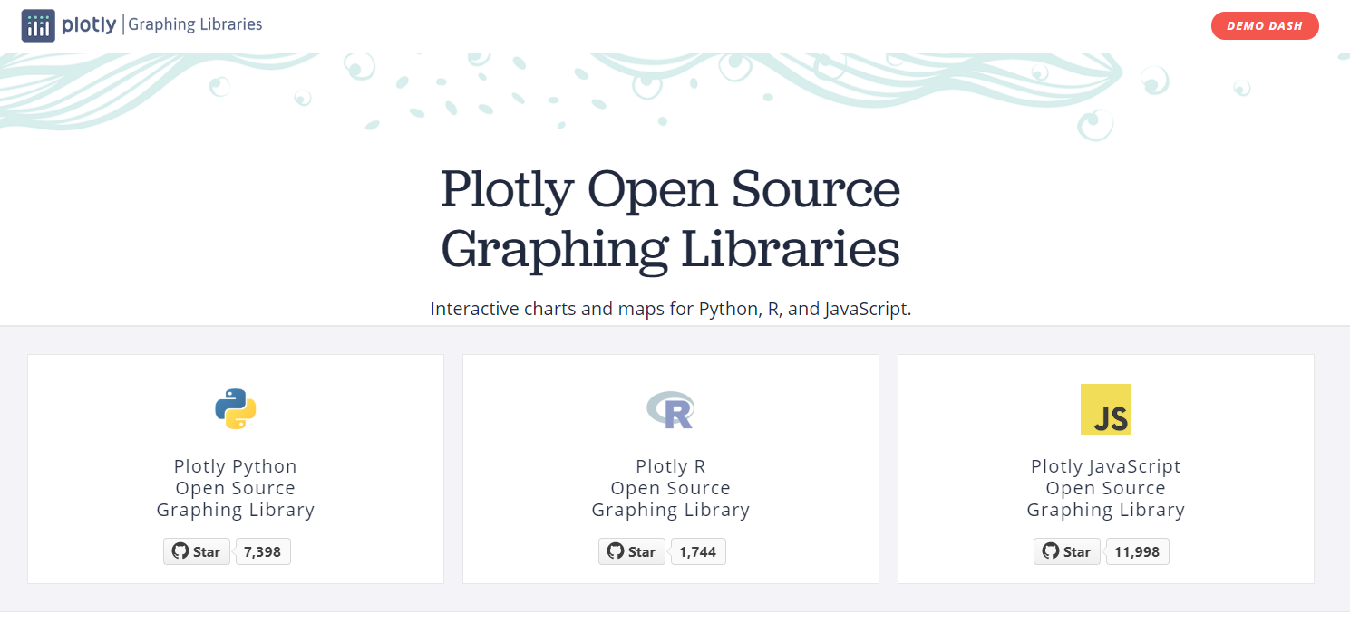
Plotly
plotly.com/graphing-libraries

Slide 55
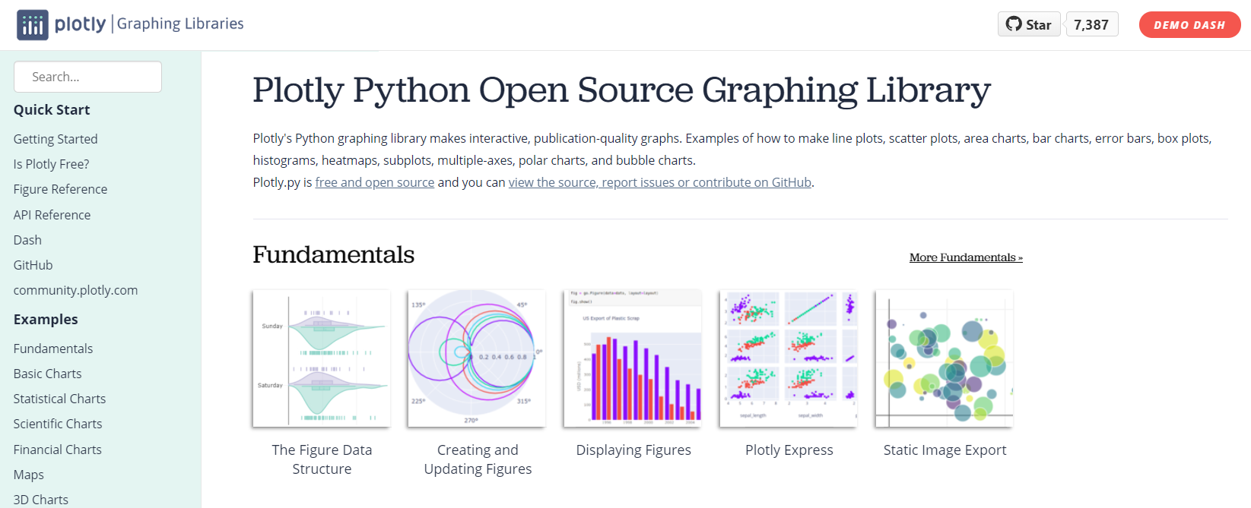
Plotly
plot.ly/python

Slide 56
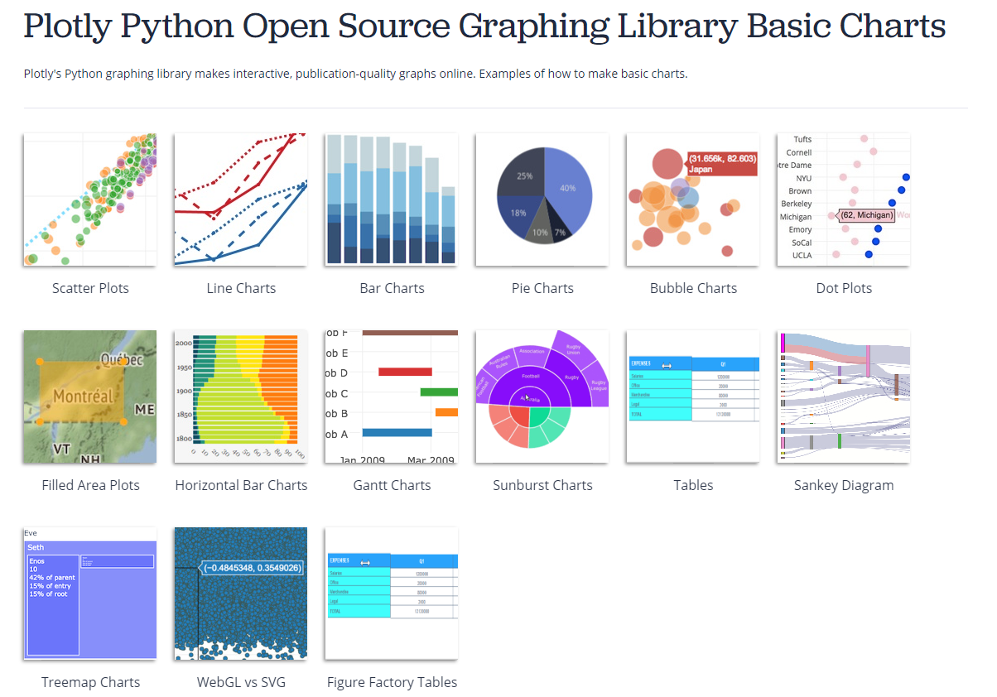
Plotly
plotly.com/python/basic-charts

Slide 57
Background
Charting libraries
Ggplot2 (R)
plotnine
MATLAB
Matplotlib
Seaborn
Holoviews
hvPlot
Bokeh
Chartify
Pandas-Bokeh
Web / Javascript
Plotly Graph Objects
@bencearato

Slide 58
Plotly Express

Slide 59
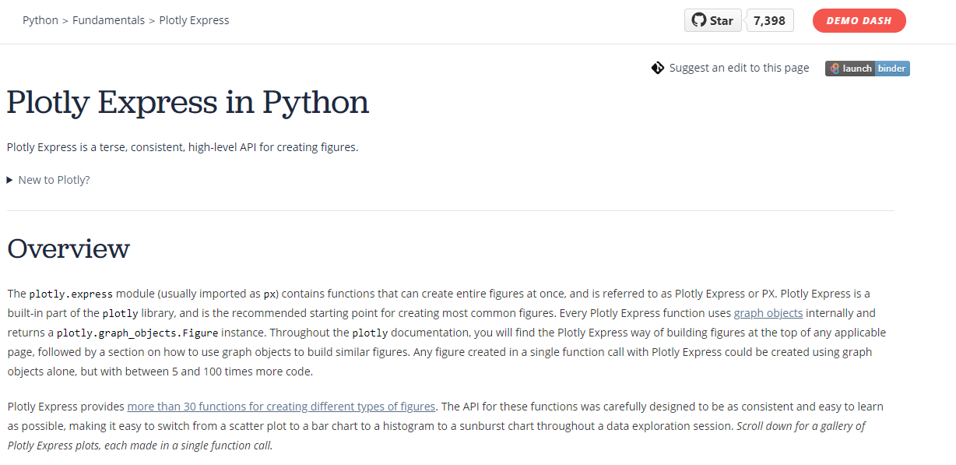
Plotly
plotly.com/python/plotly-express

Slide 60
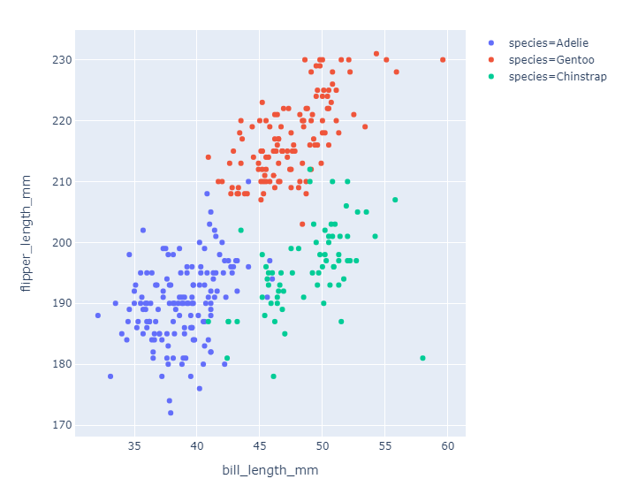
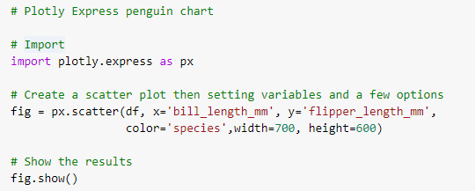
Plotly Express

Slide 61
Plotly
Background
Plotly (a Canadian company) founded in 2013, offering a hosted service powered by Plotly.js
In 2015 the core technologies has been open sourced, currently most of the Plotly stack is open source and free
Plotly has client libraries for Python and R
Since 2019 the recommended way to use Plotly is the Plotly Express library
Open source components
Plotly.js, the core Javascript dataviz library
Plotly Graph Objects, a lower-level Python chart library
Plotly Express, a higher-level declarative Python library
Dash Open Source for creating dashboards and analytical apps
Plotly also offers paid commercial products
Dash Enterprise

Slide 62
Background
Charting libraries
Ggplot2 (R)
plotnine
MATLAB
Matplotlib
Seaborn
Holoviews
hvPlot
Bokeh
Chartify
Pandas-Bokeh
Web / Javascript
Plotly Graph Objects
Plotly Express
@bencearato

Slide 63
Group #4

Slide 64
Vega & Vega-lite

Slide 65
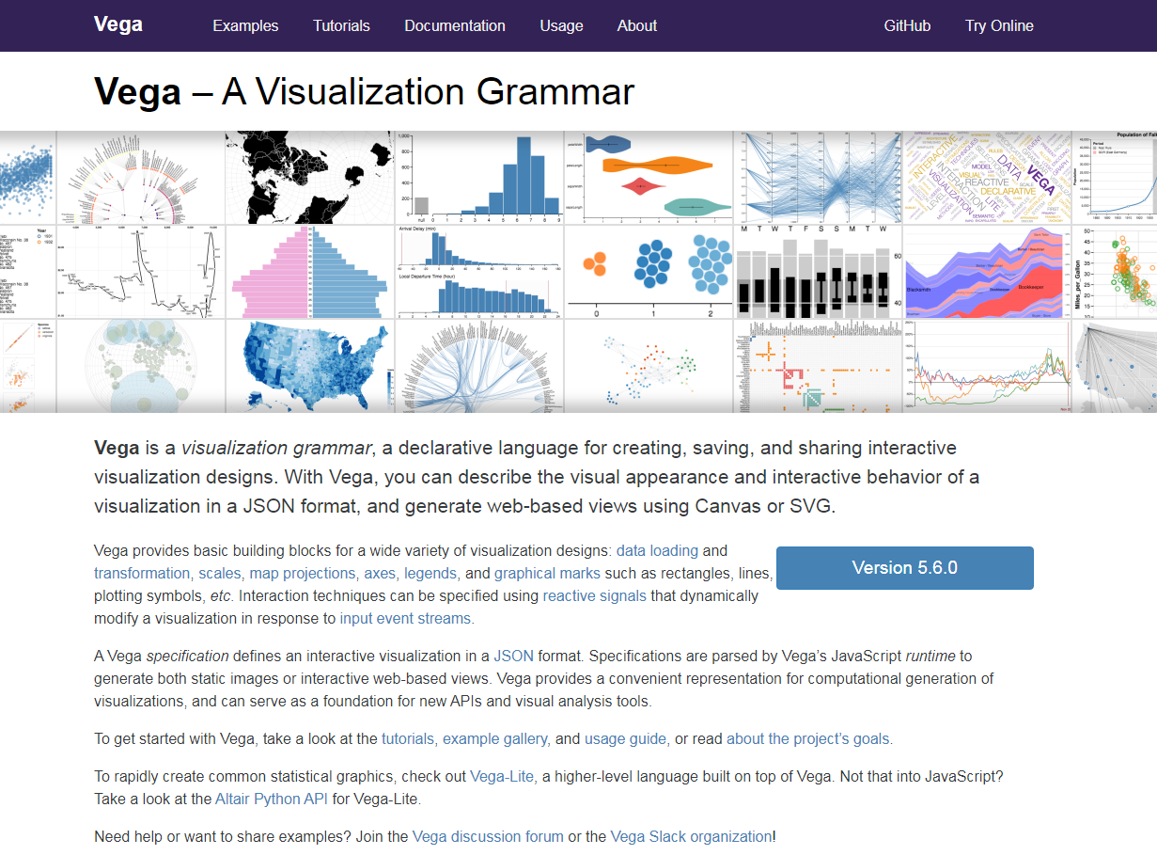
Vega & Vega-Lite
vega.github.io/vega

Slide 66
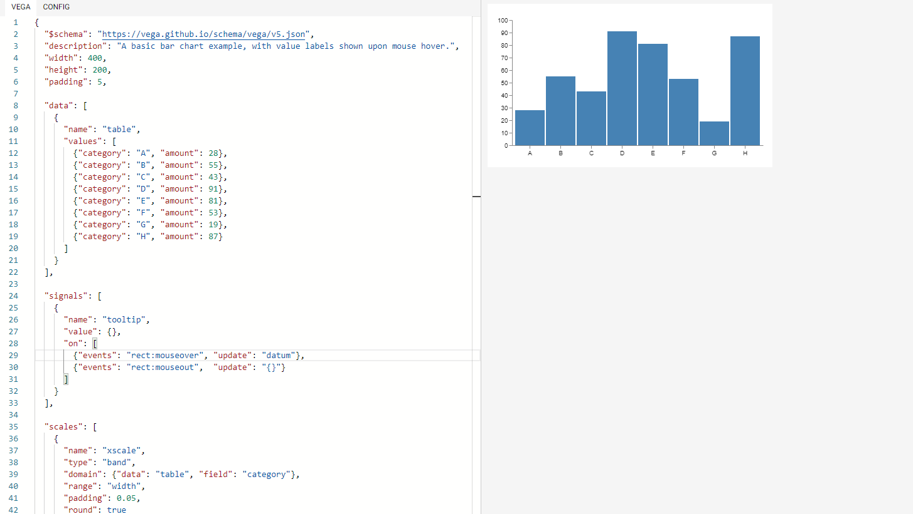
Bar chart in Vega
vega.github.io/editor/#/examples/vega/bar-chart

Slide 67
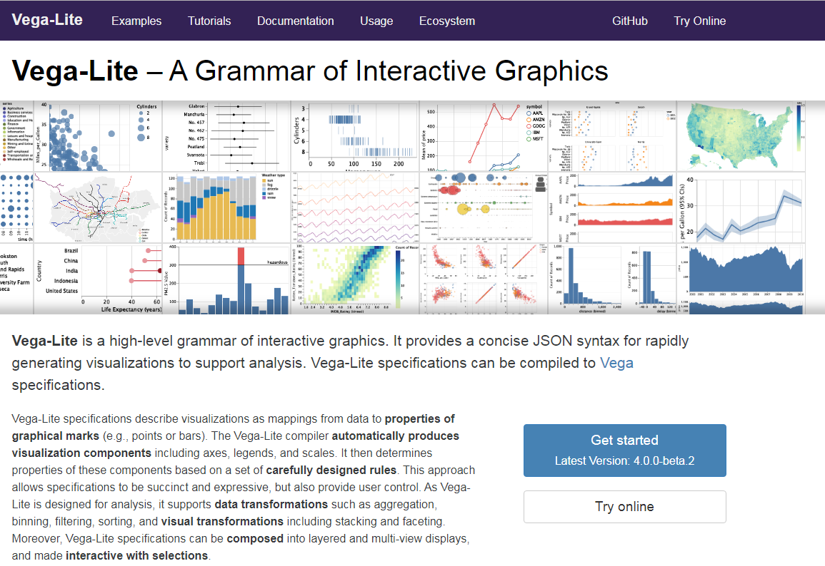
Vega & Vega-Lite
vega.github.io/vega-lite

Slide 68
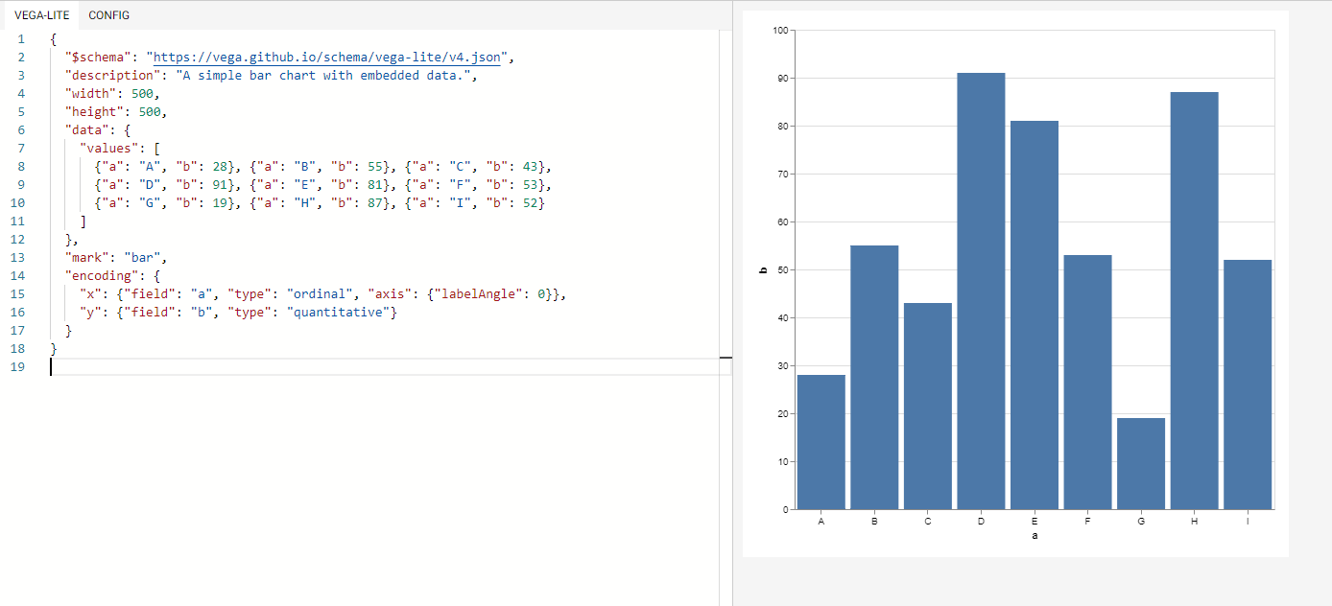
Bar chart in Vega-Lite
vega.github.io/editor/#/examples/vega-lite/bar

Slide 69
Altair

Slide 70
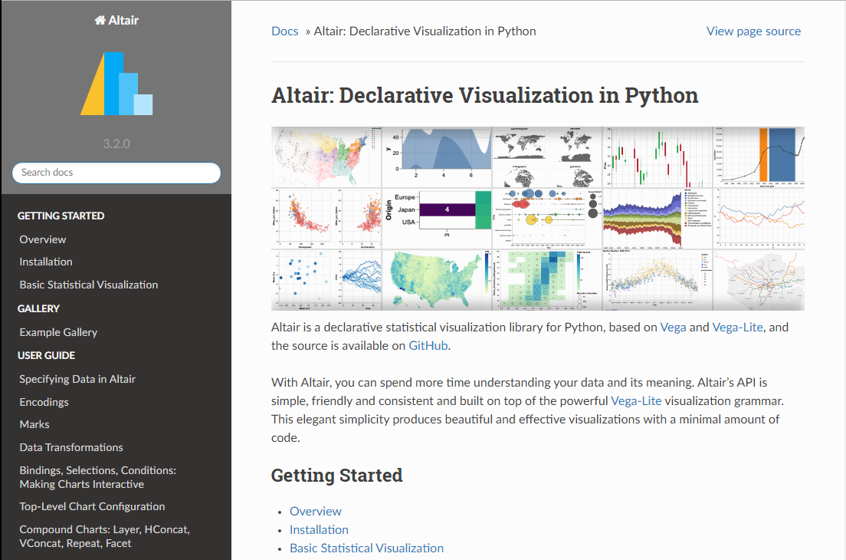
Altair
altair-viz.github.io

Slide 71
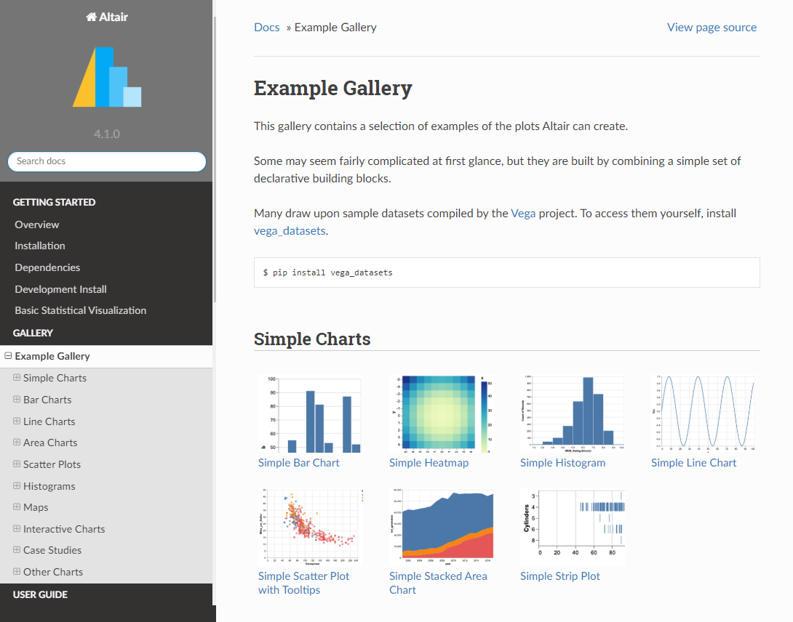
Altair
altair-viz.github.io/gallery/index

Slide 72
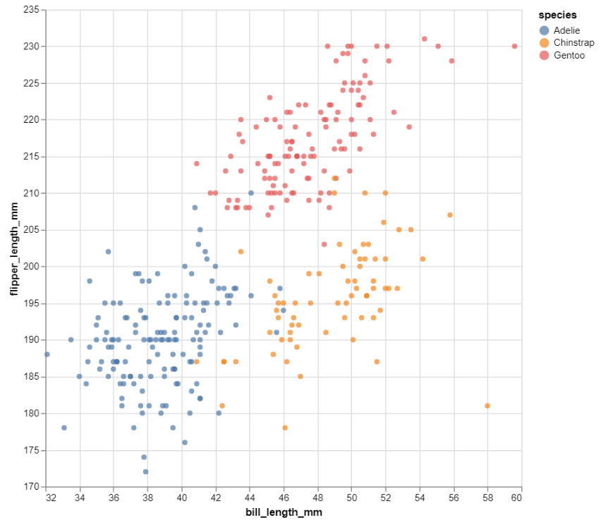
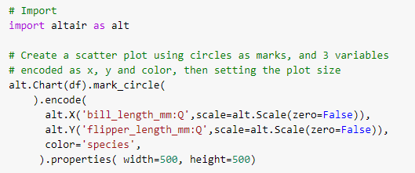
Altair

Slide 73
Vega, Vega-Lite and Altair
Vega
Vega is a visualization grammar, a declarative language for interactive visualization designs
The visual appearance and behavior of a visualization is defined in a JSON format
The JSON specification then can be rendered by JavaScript using Canvas or SVG
Vega-Lite
A higher-level visualization grammar for building interactive graphs quickly
Many visual components (axes, labels etc.) are automatically created (but can be customized)
Vega-Lite supports both data transformations (e.g., aggregation, binning, filtering, sorting) and visual transformations (e.g., stacking and faceting)
Altair
A high-level, declarative visualization library for Python, based on Vega and Vega-Lite
Started in 2016 as a collaboration between Jake VanderPlas, Brian Granger and the Interactive Data Lab at the University of Washington (UW)

Slide 74
Background
Charting libraries
Ggplot2 (R)
plotnine
MATLAB
Matplotlib
Seaborn
Holoviews
hvPlot
Bokeh
Chartify
Pandas-Bokeh
Web / Javascript
Plotly Graph Objects
Plotly Express
Vega & Vega-lite
Altair
@bencearato

Slide 75
Vega-Lite & Power BI

Slide 76
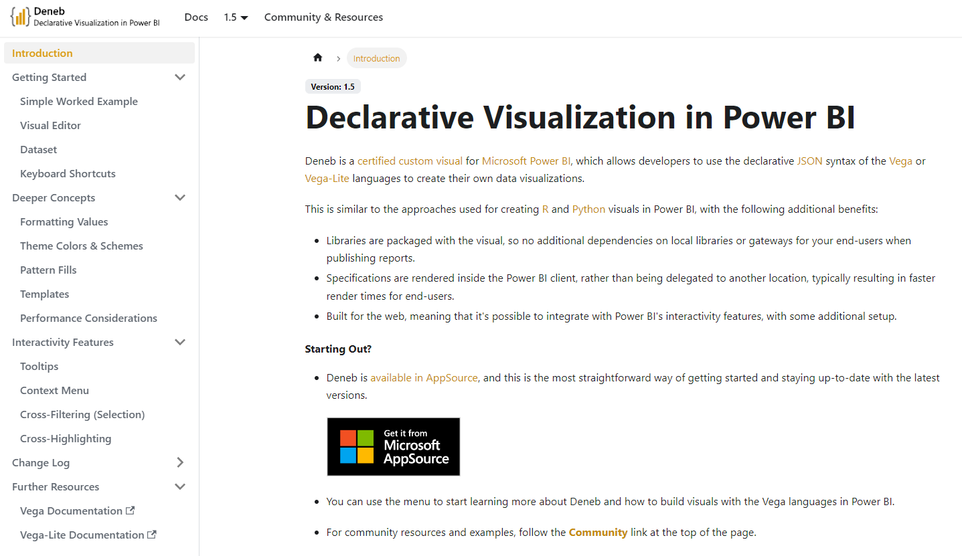
Deneb in Power BI
https://deneb-viz.github.io/

Slide 77
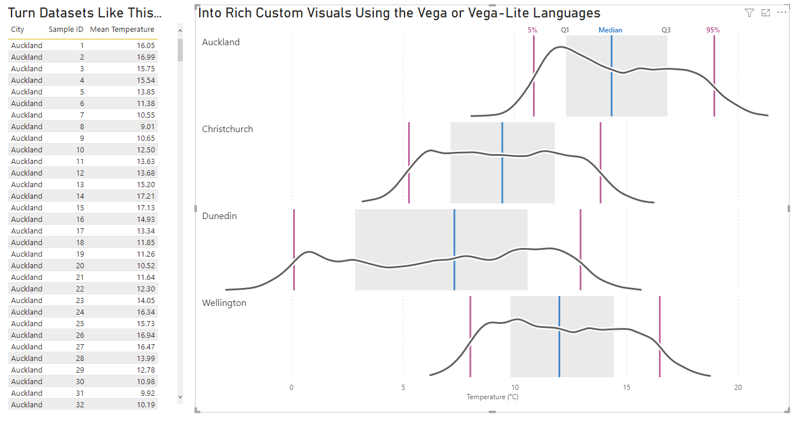
Deneb in Power BI
https://appsource.microsoft.com/en-us/product/power-bi-visuals/coacervolimited1596856650797.deneb

Slide 78
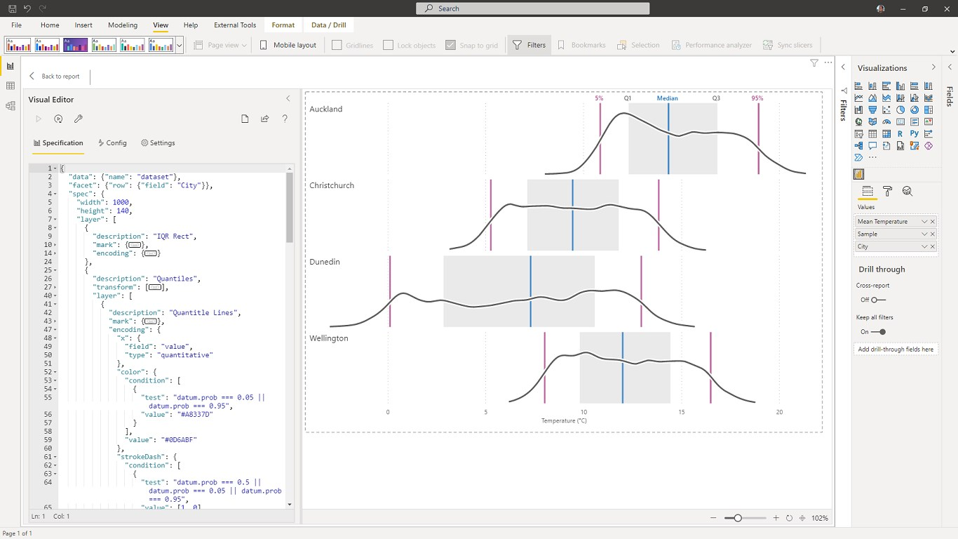
Deneb in Power BI
https://appsource.microsoft.com/en-us/product/power-bi-visuals/coacervolimited1596856650797.deneb

Slide 79
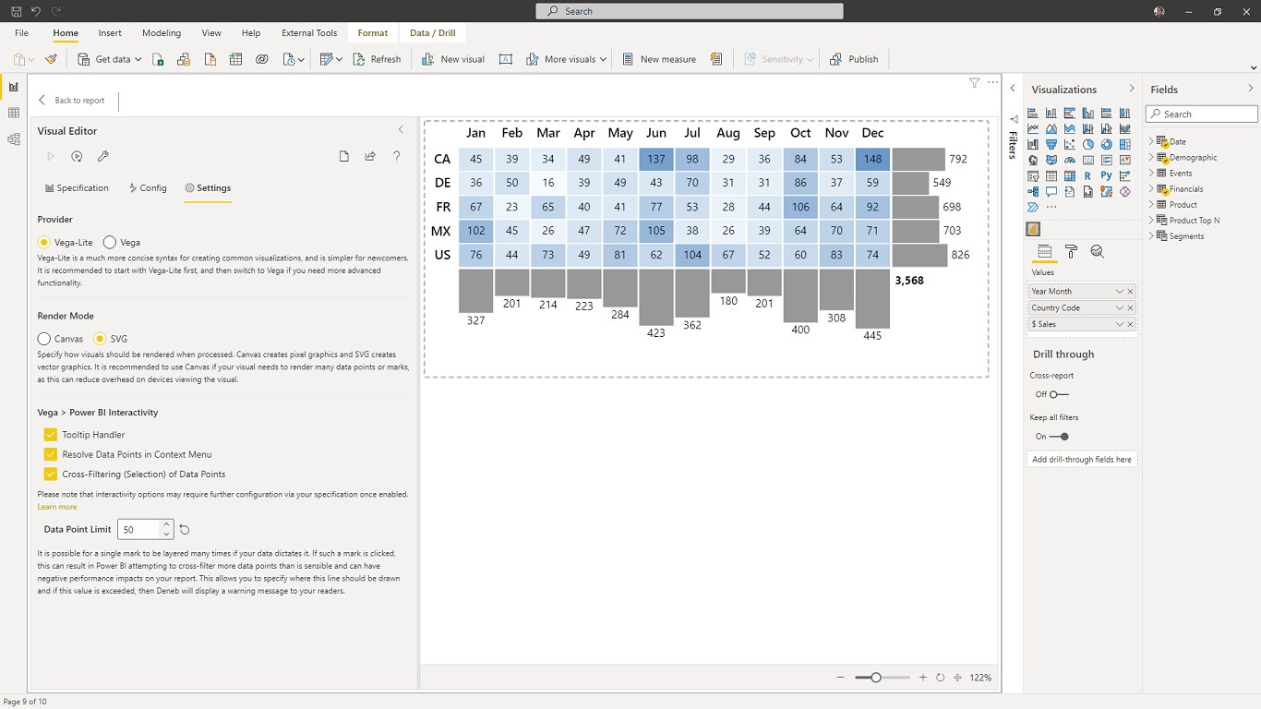
Deneb in Power BI
https://appsource.microsoft.com/en-us/product/power-bi-visuals/coacervolimited1596856650797.deneb

Slide 80
Star comparison

Slide 81
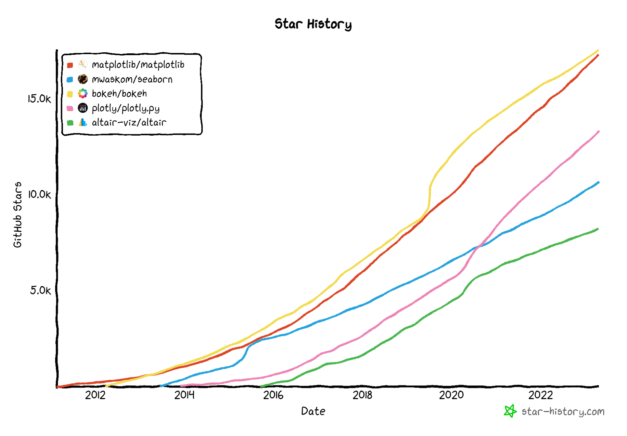
Github Star comparison
Total number of stars
Notes:
2023.04.25
https://github.com/mwaskom/seaborn

Slide 82
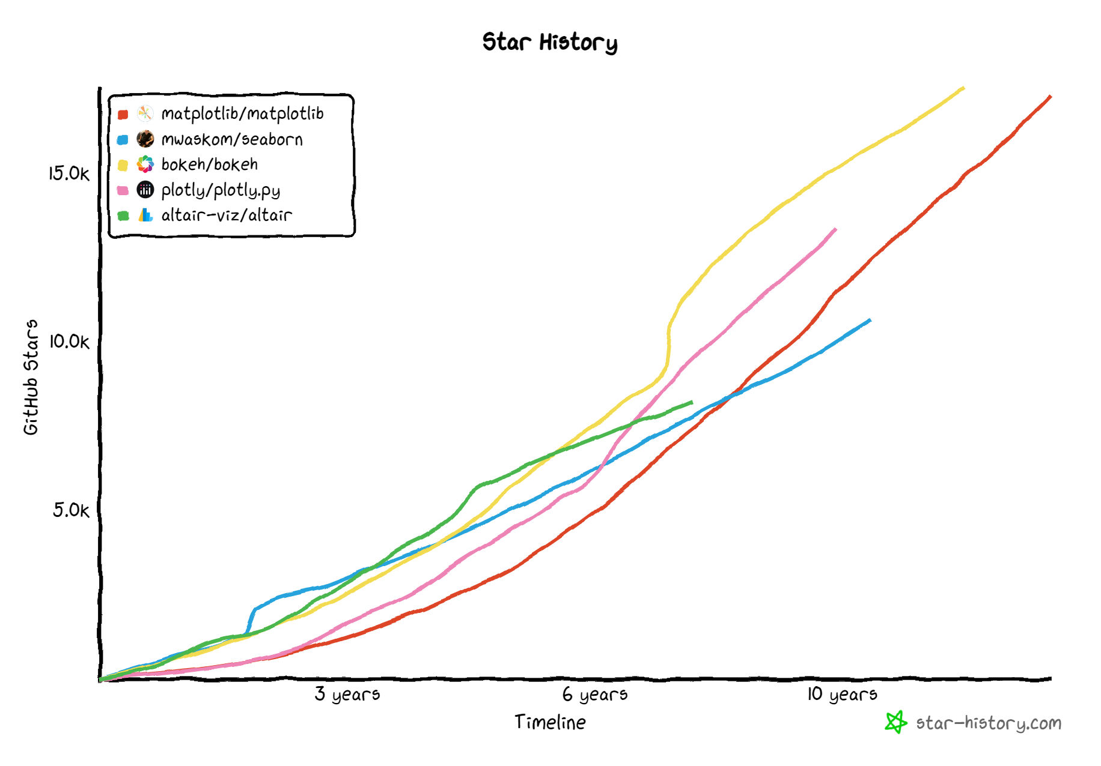
Github Star comparison
The velocity of new stars
Notes:
2023.04.25

Slide 83

Github Star comparison
Notes:
2022, hibás

Slide 84
Github Star comparison
Notes:
2022, hibás

Slide 85
Dashboards and data apps

Slide 86
Plotly Dash

Slide 87

Dash
plot.ly/dash

Slide 88

Dash
dash-gallery.plotly.host/Portal

Slide 89

Dash
dash-gallery.plotly.host/dash-oil-and-gas

Slide 90
Panel

Slide 91

Panel
panel.pyviz.org

Slide 92

Panel
panel.holoviz.org/gallery/index

Slide 93

Panel
gapminder.pyviz.demo.anaconda.com/gapminders
Notes:
https://

Slide 94

Panel
panel.holoviz.org/gallery/demos/VTKInteractive.html#demos-gallery-vtkinteractive

Slide 95

Panel
awesome-panel.org

Slide 96
Voilà

Slide 97

Voilà
voila.readthedocs.io/en/stable
Notes:
https://pandas.pydata.org/pandas-docs/stable/user_guide/visualization.html

Slide 98

Voilà
voila-gallery.org

Slide 99

Voilà
voila-gallery.org/services/gallery
Notes:
https://pandas.pydata.org/pandas-docs/stable/user_guide/visualization.html

Slide 100

Voilà
voila-gallery.org/services/gallery

Slide 101
Streamlit

Slide 102

Streamlit
www.streamlit.io

Slide 103

Streamlit
www.streamlit.io/gallery

Slide 104

Streamlit
www.streamlit.io/gallery

Slide 105

Streamlit
awesome-streamlit.org

Slide 106
Shiny for Python

Slide 107

Shiny for Python
https://shiny.rstudio.com/py/

Slide 108

Shiny for Python
https://shinylive.io/py/app/#cpu-info

Slide 109
Summary

Slide 110
Background
Charting libraries
Dashboards & Analytic apps
Ggplot2 (R)
plotnine
Voilà
MATLAB
Matplotlib
Seaborn
Panel
Holoviews
hvPlot
Plotly Dash
Bokeh
Chartify
Pandas-Bokeh
Streamlit
Web / Javascript
Plotly Graph Objects
Plotly Express
Shiny for Python
Vega & Vega-lite
Altair
@bencearato

Slide 111
References

Slide 112

PyViz.org
PyViz.org, an open guide to all Python dataviz toools

Slide 113

PyViz.org
pyviz.org/overviews

Slide 114


PyViz.org
Statistics for various libraries on PyViz.org

Slide 115

Recommended watching/reading
Jim Bendar’s talk at AnacondaCon 2020 - anacondacon.io

Slide 116

Recommended watching/reading
Talk materials from the PyData Budapest Dataviz Evolution meetup: adat.blog/2020/06/pydata-budapest-5-meetup-dataviz-evolution

Slide 117
Conclusions
We are living in the golden age of Python dataviz
Many great libraries and active development
Strong open source community and cooperation
Looking forward to what next year brings!
Talk materials
Slides will be posted on the EuroPython website and Discord
The example charts are available as a public Google Colab notebook
https://colab.research.google.com/drive/1ASlHn2VwJf4FKHJJRn4v3RssVowwsKGt
Find me on Twitter and LinkedIn:
twitter.com/bencearato
linkedin.com/in/bencearato

